Slide 1
Recognising and Translating Text from Sign-Board using OCR and Machine Learning
Mini Project
Submitted to :
Dr.G Shashidhar Koolagudi
Assistant Professor
Dept of Computer Science and Engineering
National Institute of Technology Karnataka Surathkal
Submitted by:-
Satish Avadhoot Mhetre (15CO242)
Gautham M (15CO118)
Honarao Akshay(15CO218)

Slide 2
Aim
The Aim of project is to Recognize the text in Sign Board and translate to Native languages.
The user has to take the pic of the sign board and upload to the Device
The device processes the image and creates the text output .
The output text is then translated to native languages
The sign board can be of any colour any fonts or photo taken from any angle

Slide 3
Applications
The following project can be used to help the newbie person in the region who is not able to understand the signboards in the city.
The following project can be further expanded to multi language applications

Slide 4
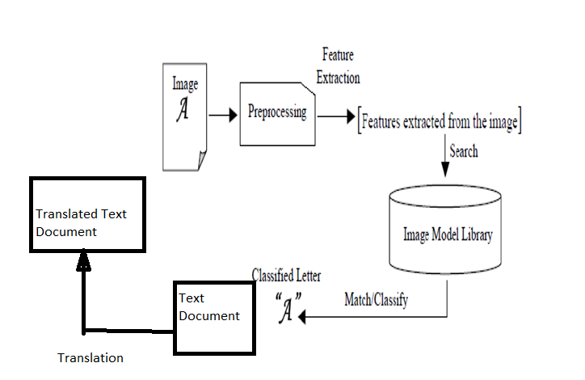
Working of the project

Slide 5
Work flow
Steps
Input Image in rgb
Do contrast changes
Do angle correction for the image
Convert image to binary
Thresholding of the image
Segment the image and classify the character
Save the text to file
7. Translate the text from file to native language

Slide 6
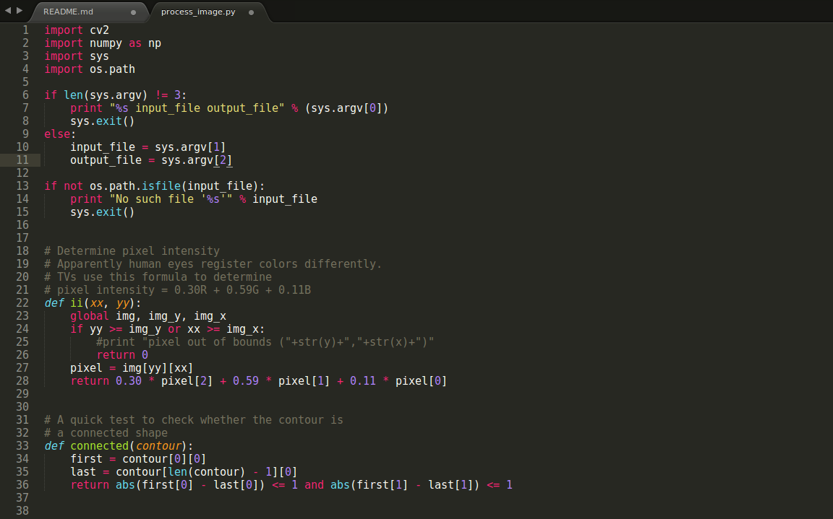
Code(Pr-processing)

Slide 7
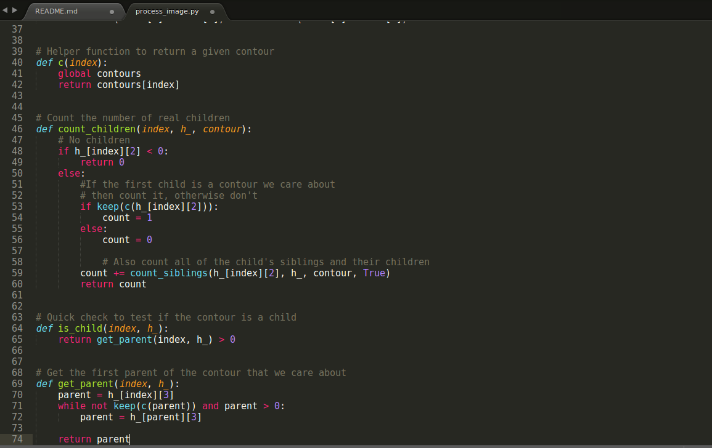

Slide 8
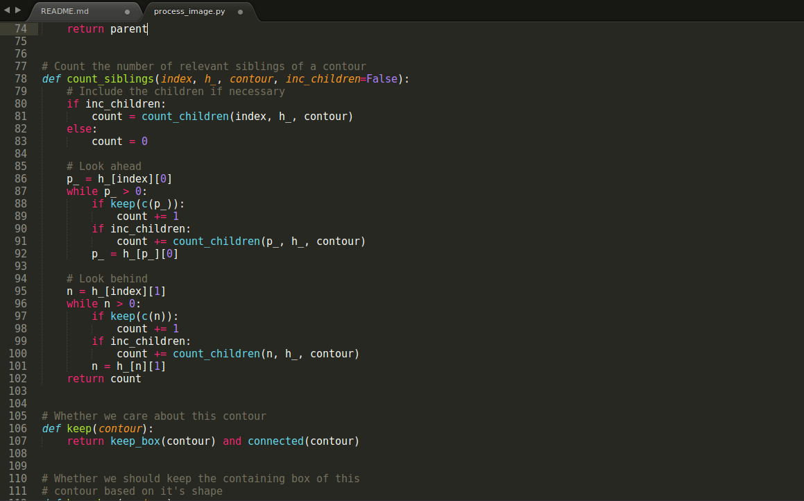

Slide 9
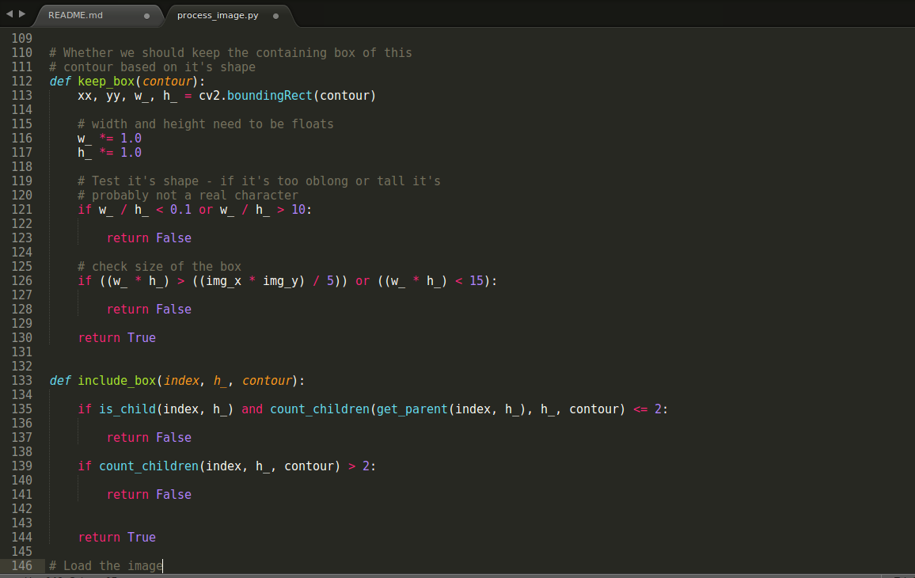

Slide 10
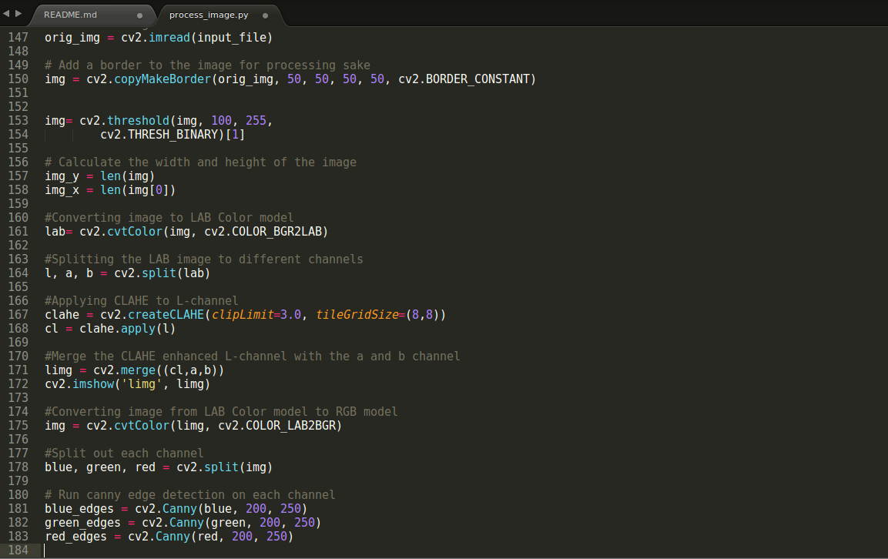

Slide 11
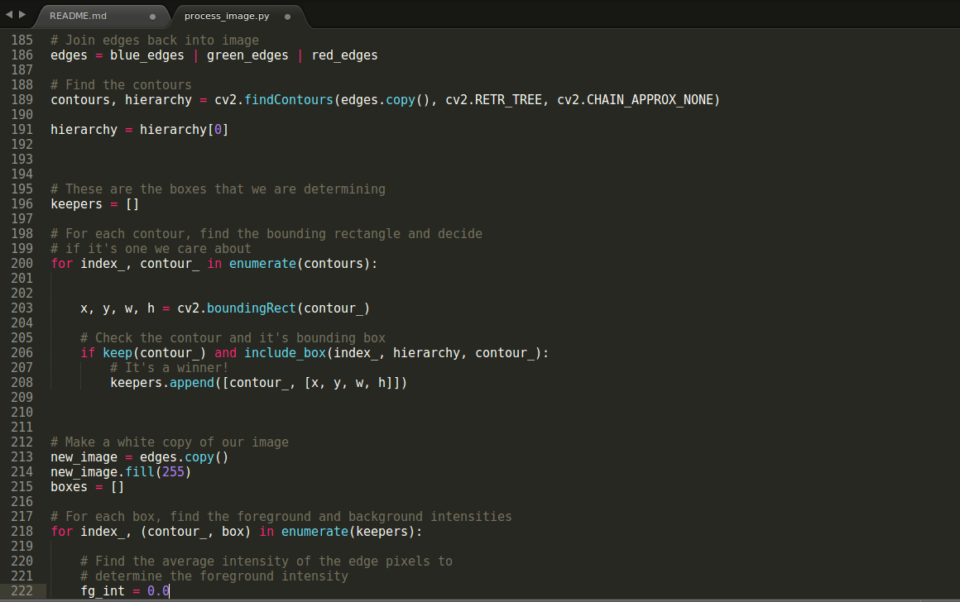

Slide 12
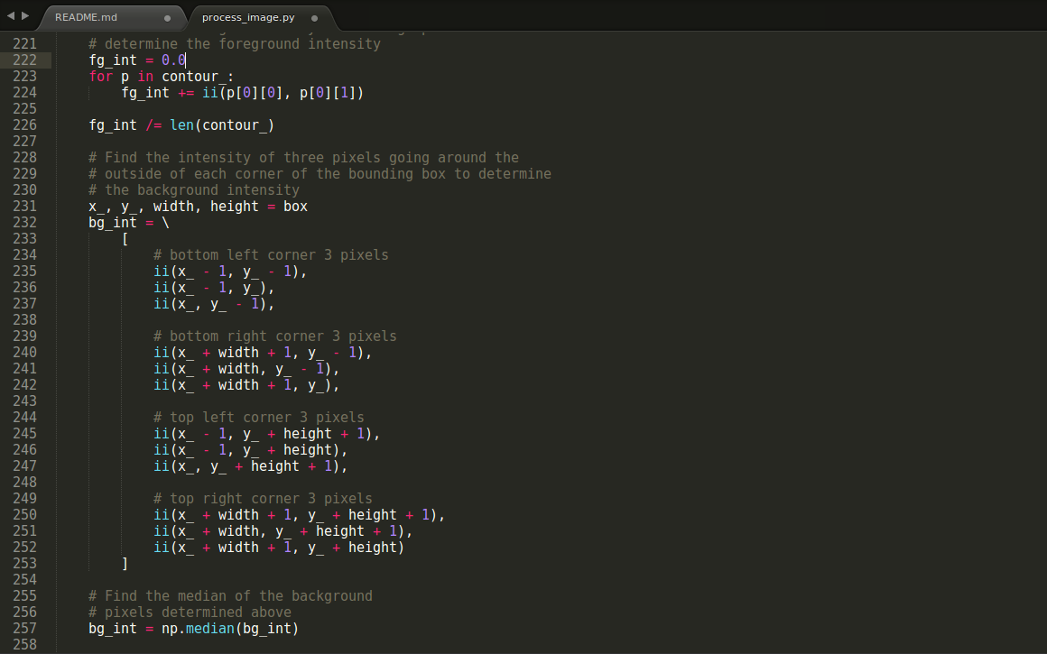

Slide 13
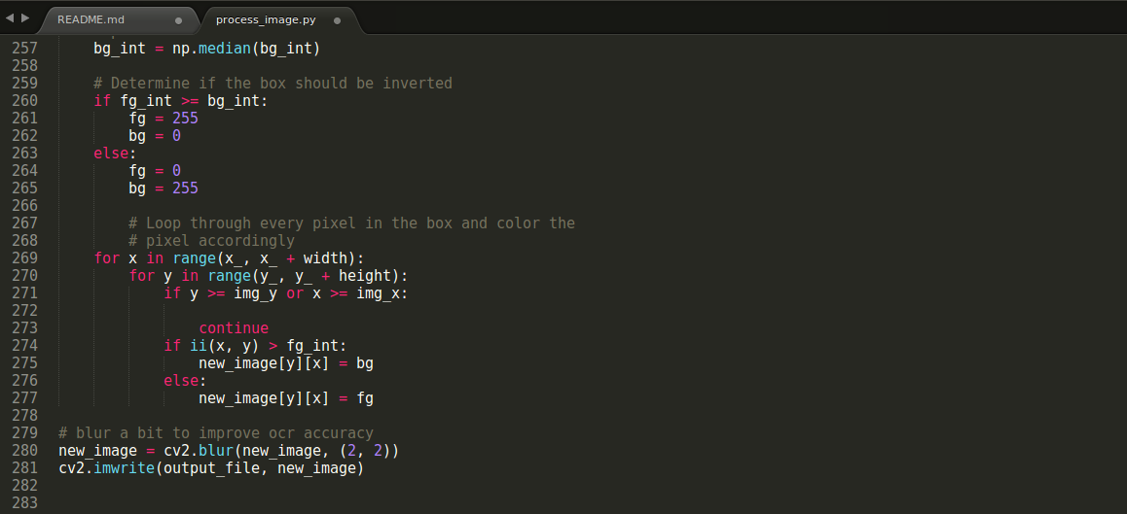

Slide 14
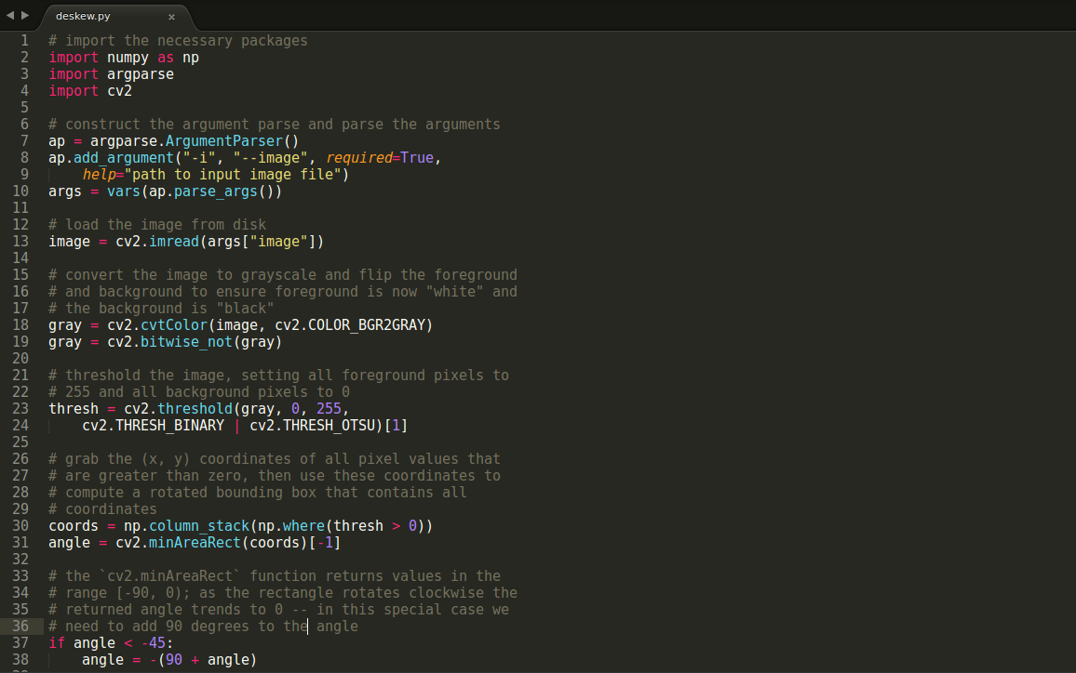
Code (De-skewing)

Slide 15
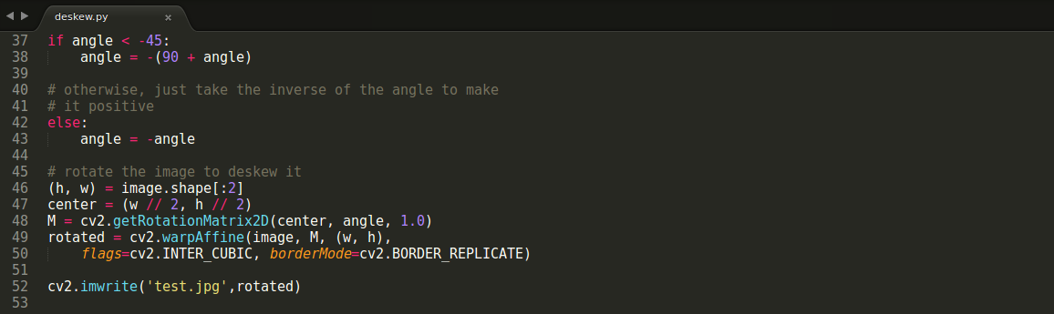

Slide 16
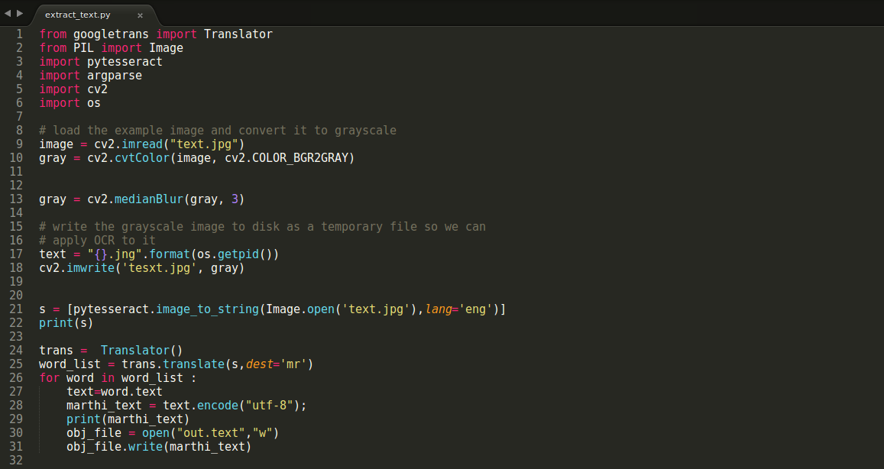
Code Text Extraction

Slide 17
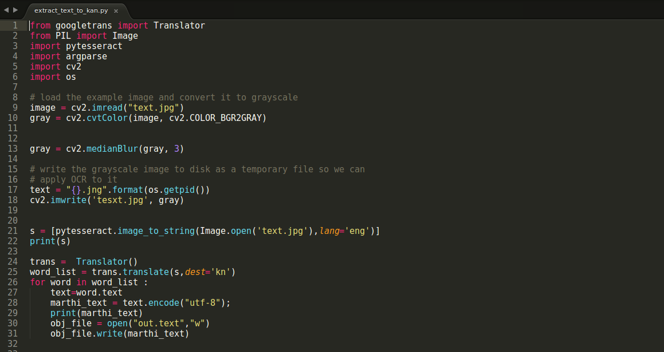
Code Translation

Slide 18


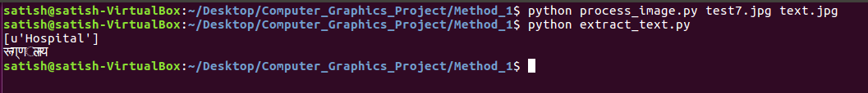
Output Screenshots
Preprocessing
Text Extraction
Translation

Slide 19
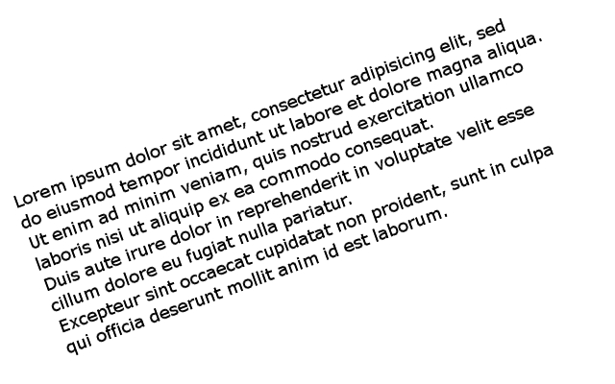
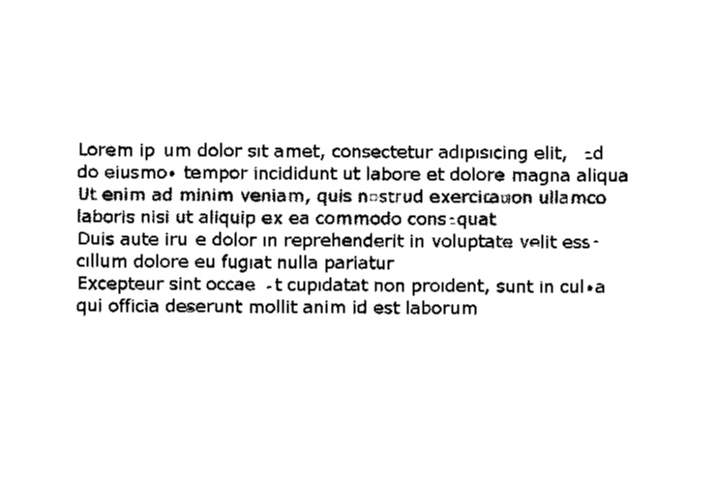
Pre Processing (Deskewing)

Slide 20
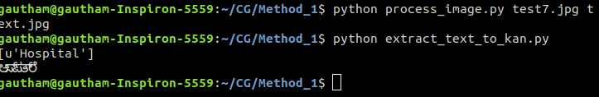
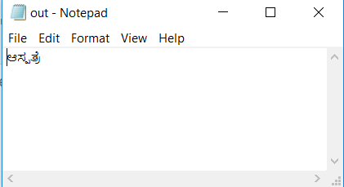

Slide 21
Advantages
The tool can be used for translation of signboards
It can be used for translation of news paper articles and images
It can be implemented on cloud so it can be used remotely
It can be implemented locally on android devices (since android has linux kernel)

Slide 22
Disadvantages
The project cannot be implemented in small memory devices locally as it takes memory to process
The project cannot detect the text in multi text images that is part of the image is written in one angle and the other part in other angle
The project does not work normally when image distortion and noise is above certain threshold

Slide 23
Conclusion and future work
The project can be implemented in android device locally or through cloud
The project can be integrated with adobe photoshop or other apps so as image quality can be improved on device before upload
Text translation can be done using more rigorous training using seq to seq neural network

